Slide 1
Team
Sprint 5
Reed Inderwiesche, Jacob Moore, James Craig, Zack Sprague, Josh McGuire, Chris Wells

Slide 2
Reed Inderwiesche – Team Leader
Sprint 5 task: Make the user able to add and delete books from the cart on the userpage.
Before: The user page’s cart was static and unmodifiable
Now: User can delete books from cart, and add a book to their cart (a placeholder book right now)
Next task for Sprint 6: Complete Add to Cart function on book pages so users can add books to their cart from the book’s page

Slide 3
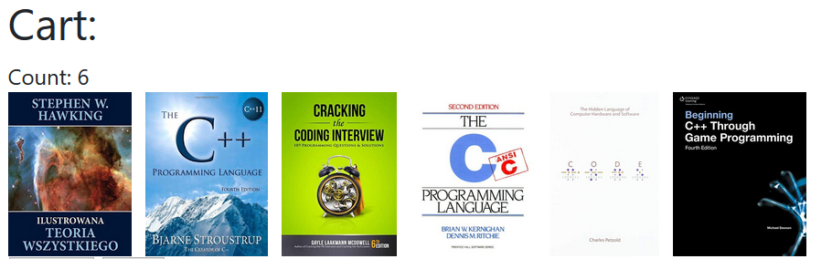
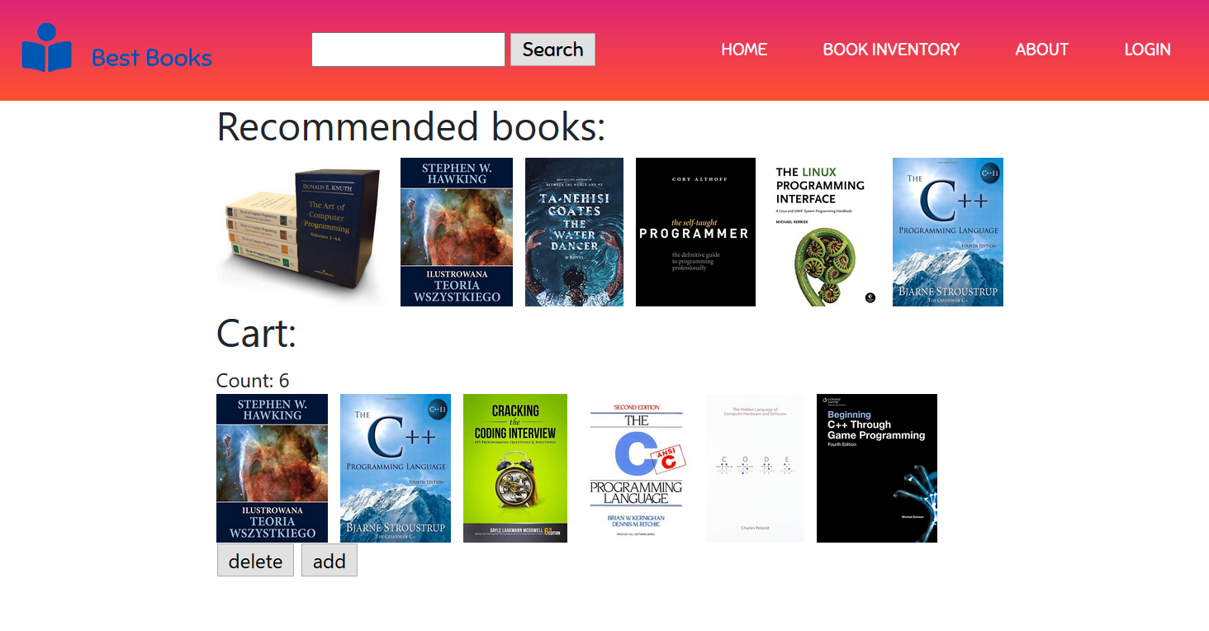
Page changes

Slide 4
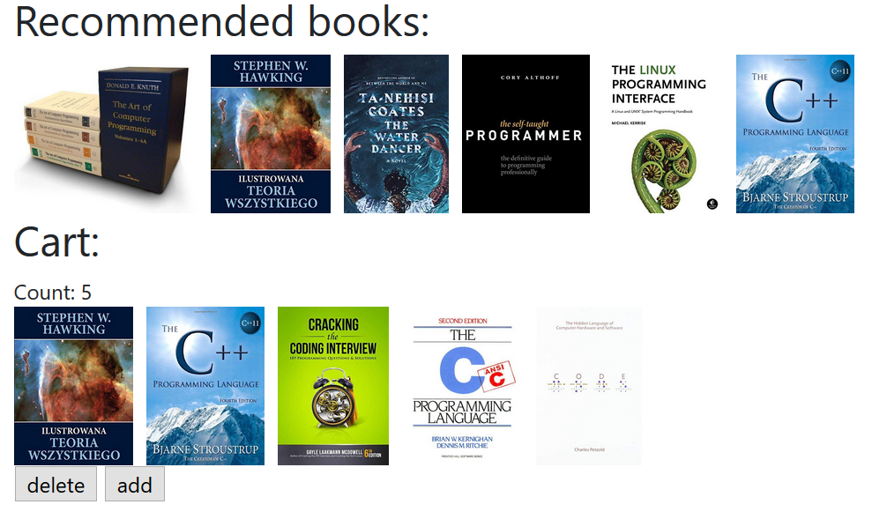
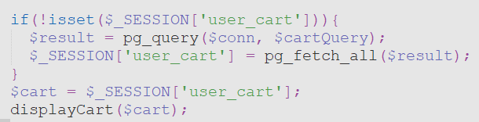
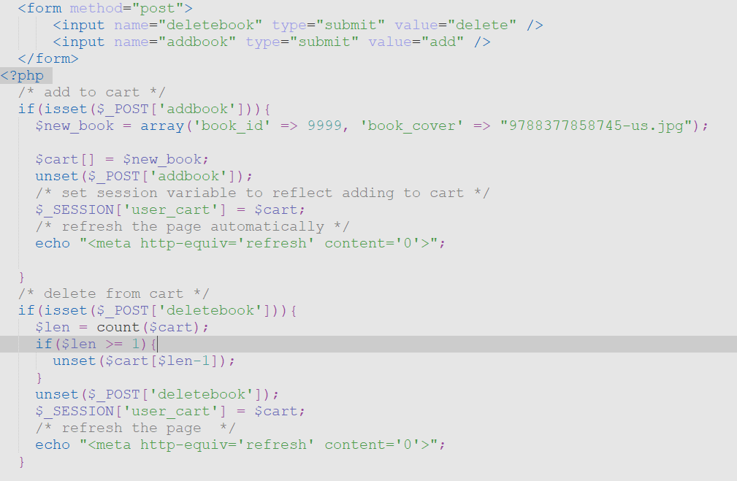

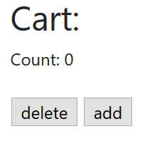

Slide 5
Jacob Moore/Tester
Task:
Populate the users page with real data from the session.
Edit existing functions to accommodate new session data.
Add real links to recommended books.
Notes:
Ensuring that goals, scope, and product domain are understood by everyone on the Scrum Team as well as possible;

Slide 6
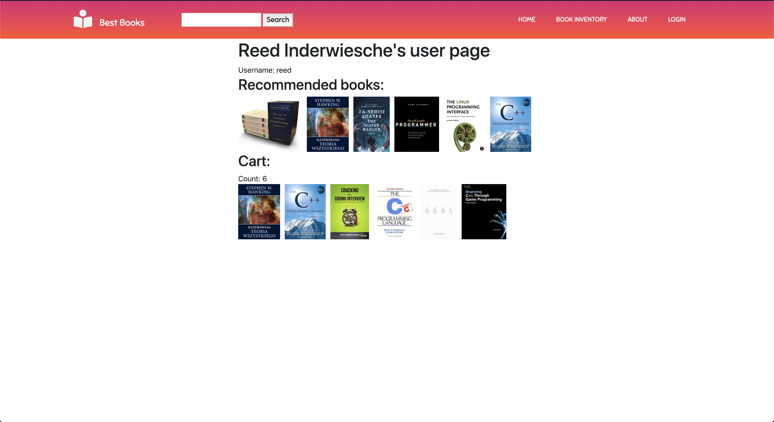
Jacob Moore/Tester
Notes:
Ensuring that goals, scope, and product domain are understood by everyone on the Scrum Team as well as possible;

Slide 7
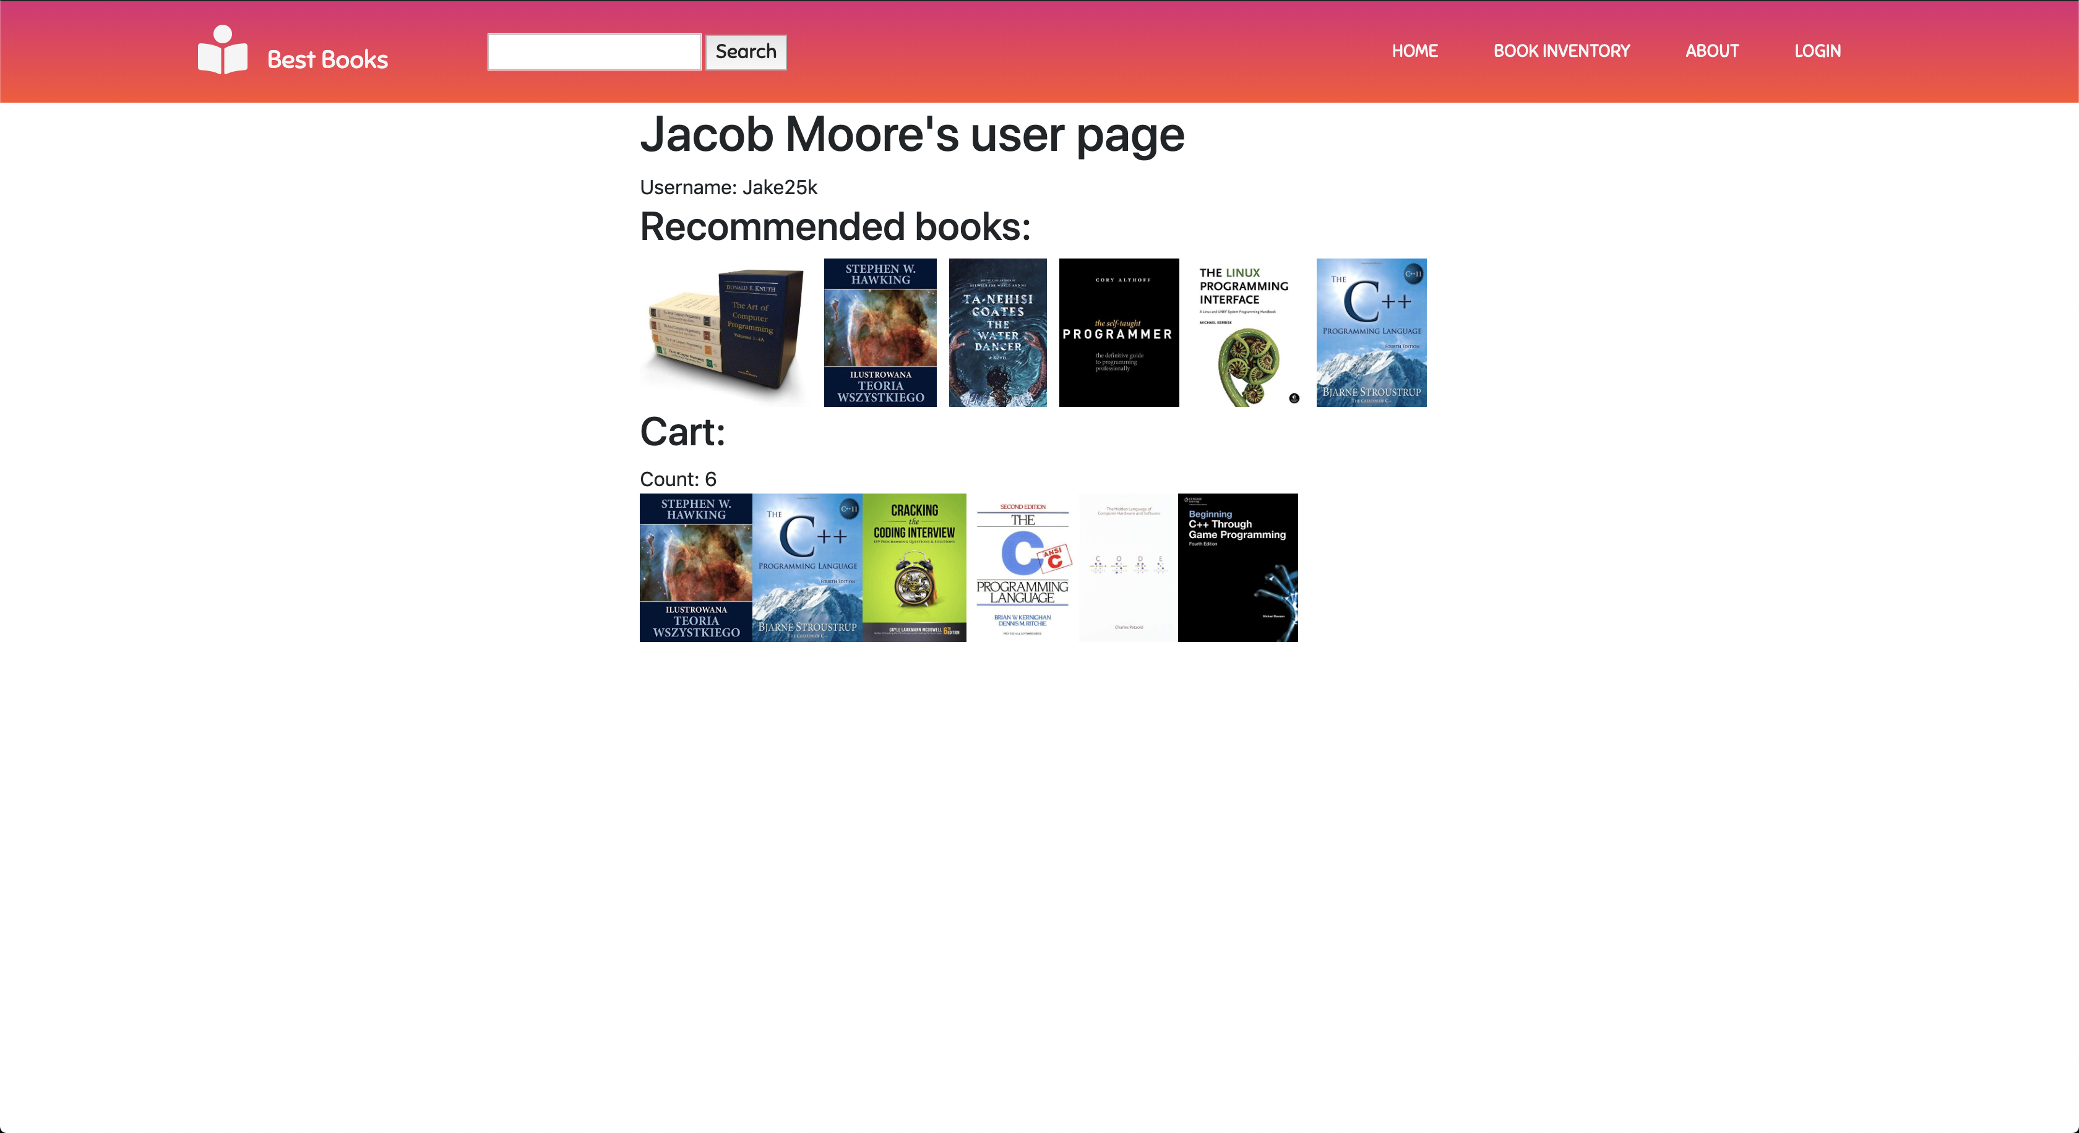
Jacob Moore/Tester
Notes:
Ensuring that goals, scope, and product domain are understood by everyone on the Scrum Team as well as possible;

Slide 8
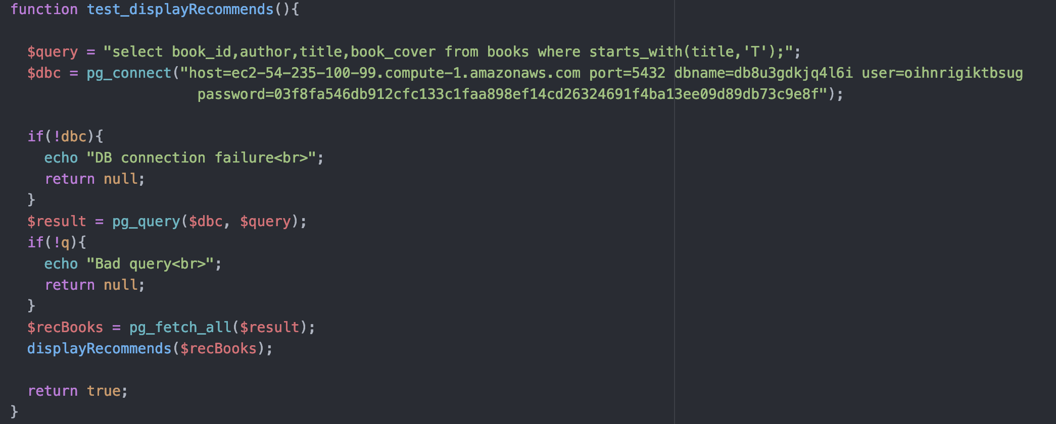
Jacob Moore/Tester
Testing:
Output: True (PASS)
Notes:
Ensuring that goals, scope, and product domain are understood by everyone on the Scrum Team as well as possible;

Slide 9
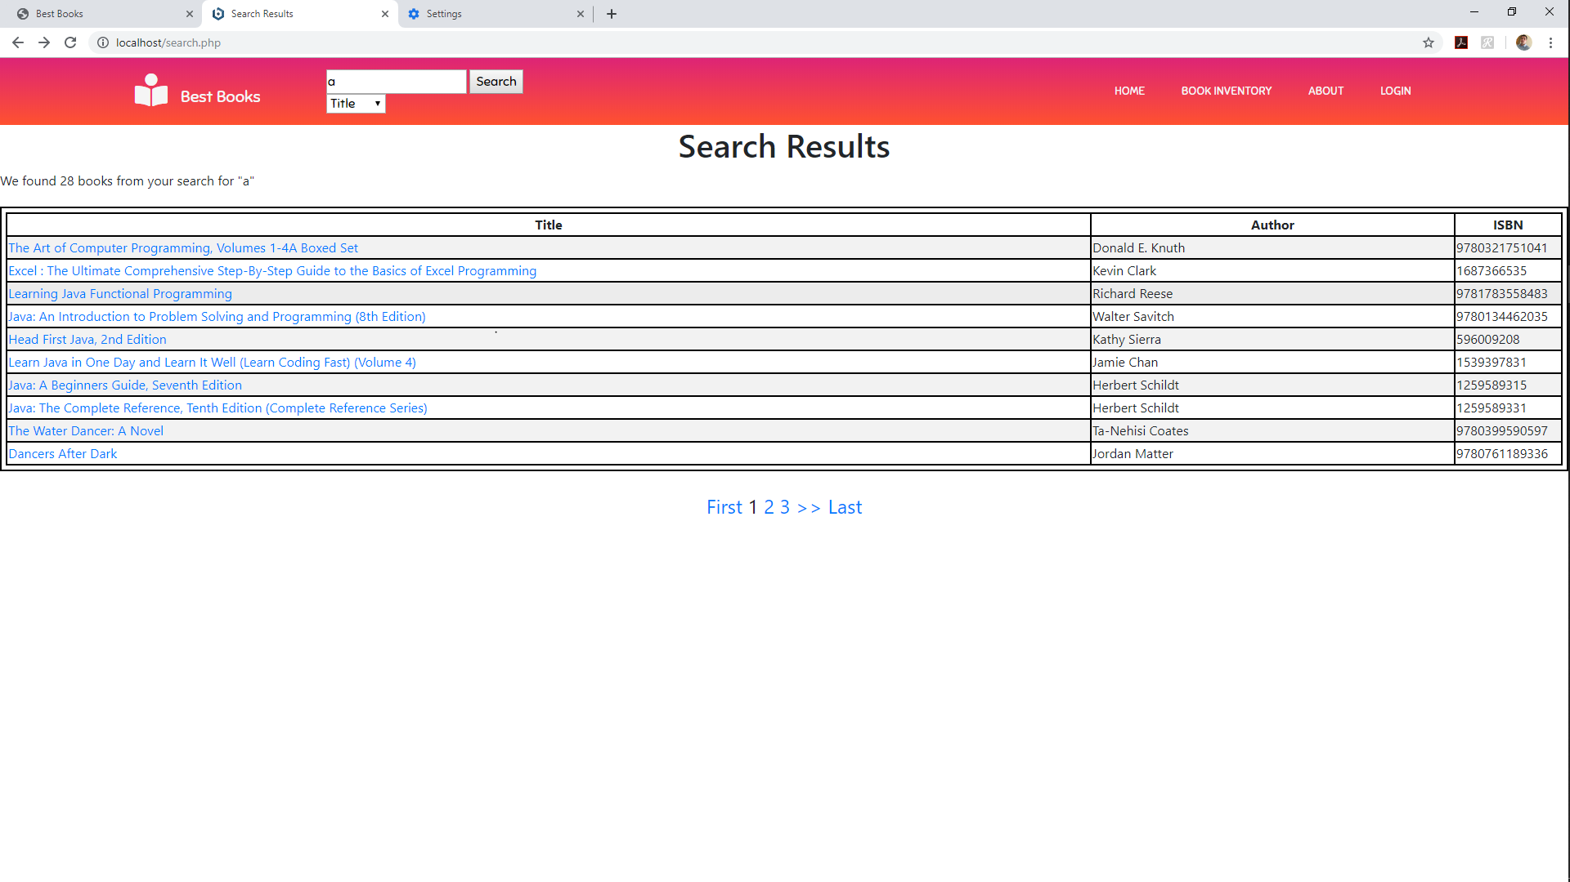
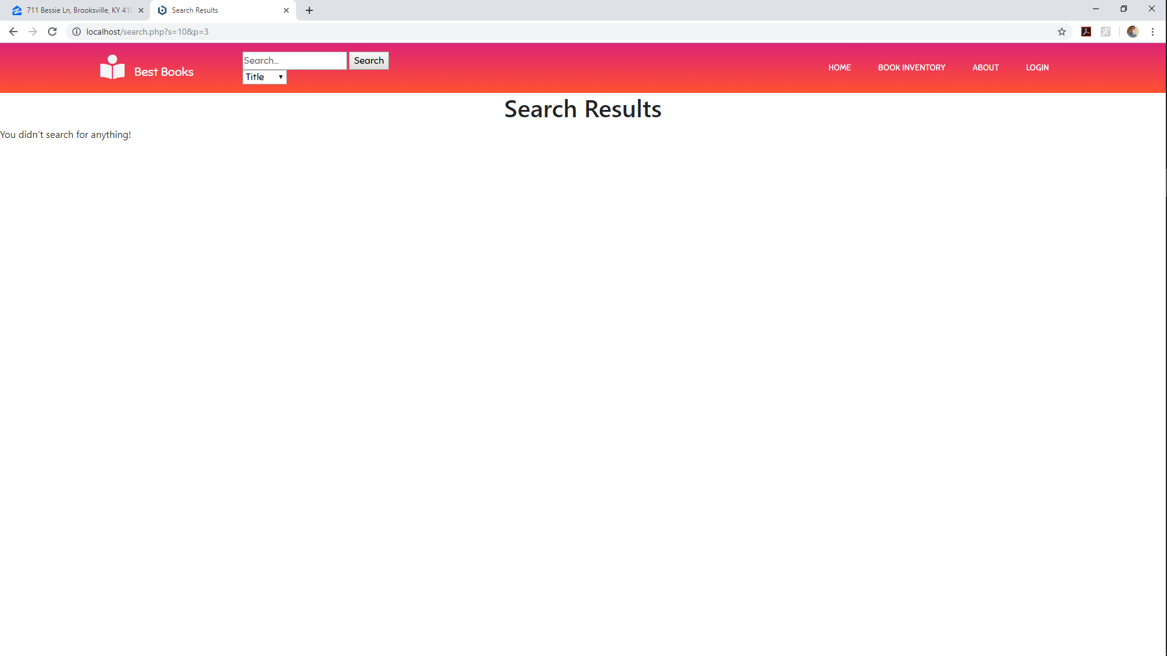
Build Manager: James Craig
Paging to the search page, not fully functional

Slide 10


Configuration Manager: Zack Sprague
Fixed the login button to change to logout once the user is logged in.
Refactoring of login and login functions.
Added header and footer files for ease of readability.

Slide 11
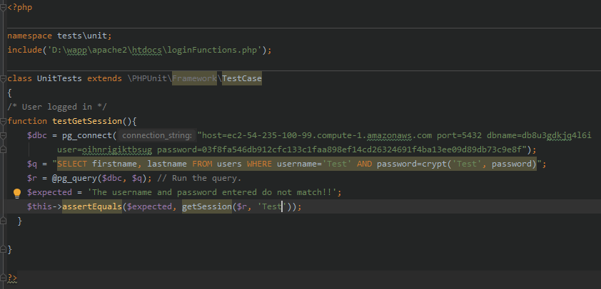
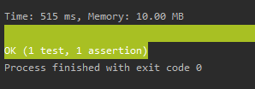
PHP Unit Test

Slide 12
SCM Manager: Josh Mcguire Database Connect with SQL querys
$db_con = pg_connect("host=ec2-54-235-100-99.compute-1.amazonaws.com port=5432 dbname=db8u3gdkjq4l6i user=oihnrigiktbsug password=03f8fa546db912cfc133c1faa898ef14cd26324691f4ba13ee09d89db73c9e8f");
$query = pg_query($db_con, "SELECT COUNT(*) from books");
$query2 = pg_query($db_con, "SELECT COUNT(*) from users");

Slide 13

Query to get count of rows
$result = pg_fetch_row($query);
$result2 = pg_fetch_row($query);
Bugged so it does not show up on the webpage.

Slide 14


Tester: Chris Wells
Simplified search bar by removing the search type. The SQL query is now capable of searching across ISBN, author, and title without specification.
Before
After

Slide 15
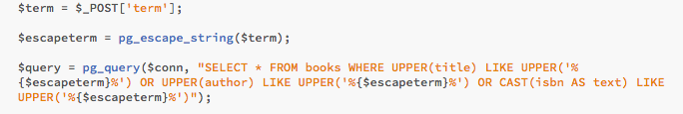
Tester: Chris Wells
Modified Code

